Slide 1

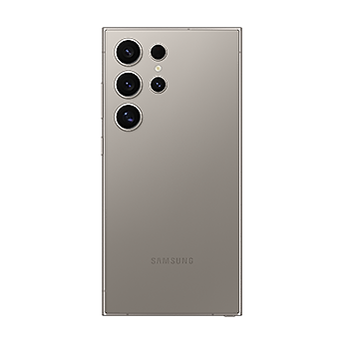
Apple, Samsung, and COVID
Iram Anwar, Jenique Fahie, Anthony Lopez, and Vinay Madhugiri Present:
How A Once-in-a-Generation Pandemic Impacted Two of the Largest Corporations on Earth

Slide 2
Goals
Analyze the financial data of Apple and Samsung
Evaluate their performance before, during, and after the COVID-19 Pandemic
Compare Apple and Samsung to the rest of the Technology Sector

Slide 3
Questions
How did Apple and Samsung’s stock prices trend before, during and after the Covid-19 pandemic?
Did the trading volume of Apple and Samsung increase or decrease during the pandemic?
How long did it take for apple and Samsung to reach to pre pandemic levels?
How did Apple and Samsung perform compared to the overall technology sector during the pandemic?
Was there an increase in stock price volatility for Apple and Samsung during the pandemic compared to pre – Covid period?
Which phone company performed best before, during and after the pandemic?

Slide 4
How did Apple and Samsung’s stock prices trend before, during and after the Covid-19 pandemic?
APPLE (Pre-COVID)
Linear uptrend throughout 2017 and most of 2018
Reversal and downtrend at end of 2018
Rebound and uptrend in 2019
SAMSUNG (Pre-COVID)
Strong 2017
Downturn in 2018
Uptrend in 2019, reached 2017 peaks

Slide 5
How did Apple and Samsung’s stock prices trend before, during and after the Covid-19 pandemic?
APPLE (During COVID)
Rapid retracement and before a rapid upturn
Significant Price increases, increased volatility
Potential returns reached around 191% over two years
SAMSUNG (During COVID)
Initial retracement before 125% Price surge
Price Peaked in 2021
Downtrend in 2022

Slide 6
How did Apple and Samsung’s stock prices trend before, during and after the Covid-19 pandemic?
APPLE (After COVID)
Consolidated between $125 and $175 throughout 2022
Early 2023 saw a sharp increase from $125 to $150, continuing to nearly $200 by the end of 2023
Early 2024 retracement before skyrocketing to highest price since 2017
SAMSUNG (After COVID)
Uptrend from 2022 onward

Slide 7
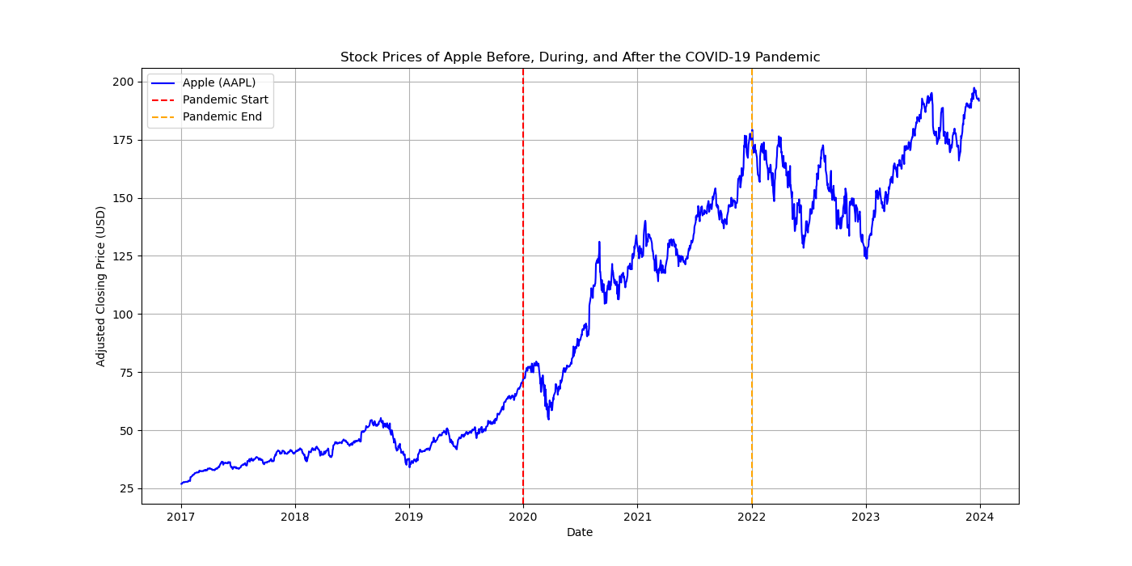
How did Apple and Samsung’s stock prices trend before, during and after the Covid-19 pandemic?

Slide 8
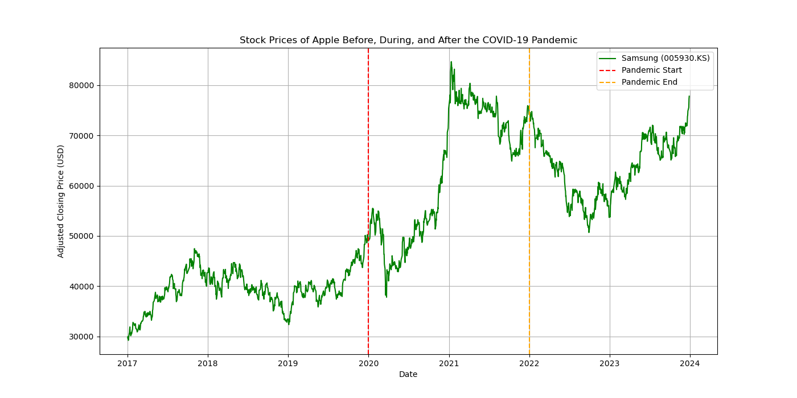
How did Apple and Samsung’s stock prices trend before, during and after the Covid-19 pandemic?

Slide 9
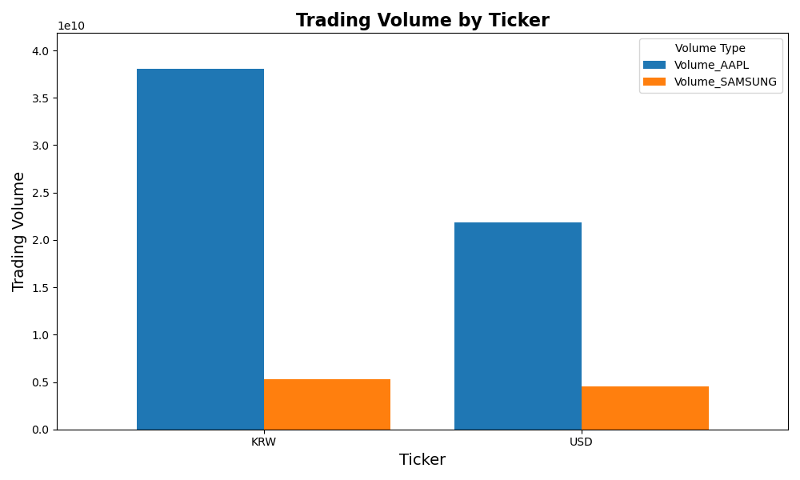
Did the trading volume of Apple and Samsung increase or decrease during the pandemic?
Both an increase in trading during the pandemic
Driven by demand for consumer electronics
Digital Services were instrumental to Apple’s increases

Slide 10
How long did it take for Apple and Samsung to reach to Pre-Pandemic levels?
Pre-Pandemic Levels defined as Highest Price in Q1 of 2020
Apple’s Pre-Pandemic High was 3/4/2020
Samsung’s Pre-Pandemic High was 2/14/2020
Difference in Pre-Pandemic Highs likely due to external factors
Apple reached Pre-Pandemic Levels faster than Samsung
Apple reached Pre-Pandemic Levels on 5/7/2020
Samsung reached Pre-Pandemic Levels on 11/16/2020

Slide 11
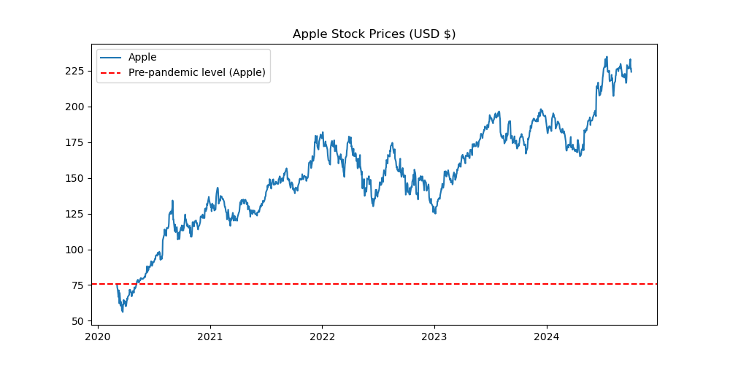
How long did it take for Apple and Samsung to reach to pre pandemic levels?

Slide 12
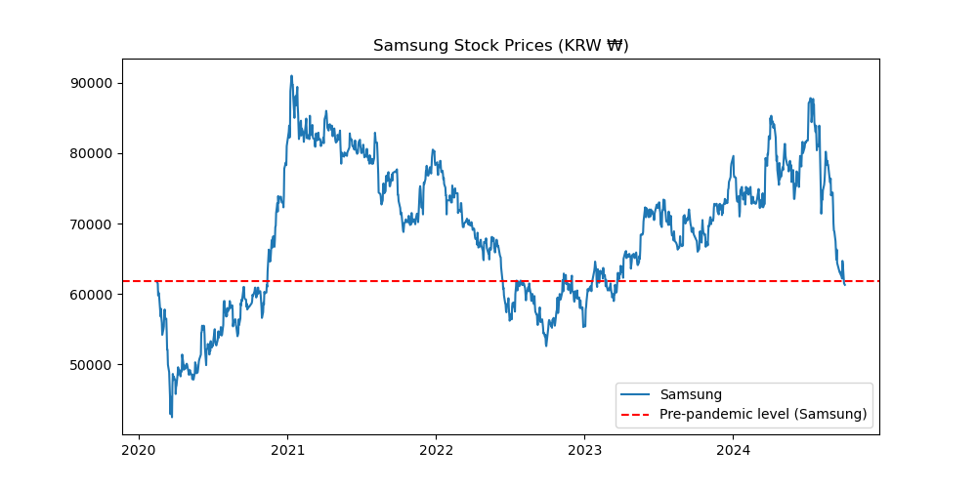
How long did it take for Apple and Samsung to reach to pre pandemic levels?

Slide 13
How did Apple and Samsung perform compared to the overall technology sector during the pandemic?
Both outperformed the broader sector
Sector boomed due to demand for technology
Apple and Samsung benefited more than others due to market position

Slide 14
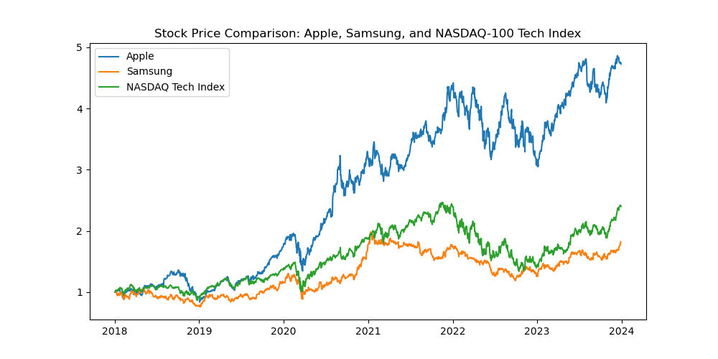
How did Apple and Samsung perform compared to the overall technology sector during the pandemic?

Slide 15
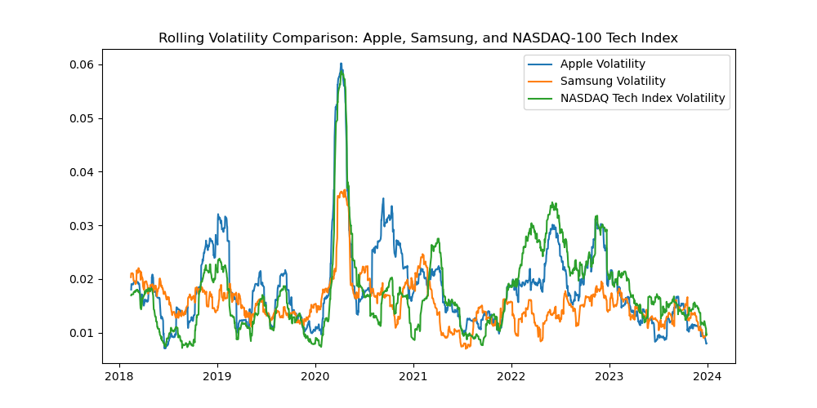
How did Apple and Samsung perform compared to the overall technology sector during the pandemic?

Slide 16
Was there an increase in stock price volatility for Apple and Samsung during the pandemic compared to pre – Covid period?
There was increased volatility at the start of the pandemic
Prices stabilized as post-pandemic economic recovery began

Slide 17
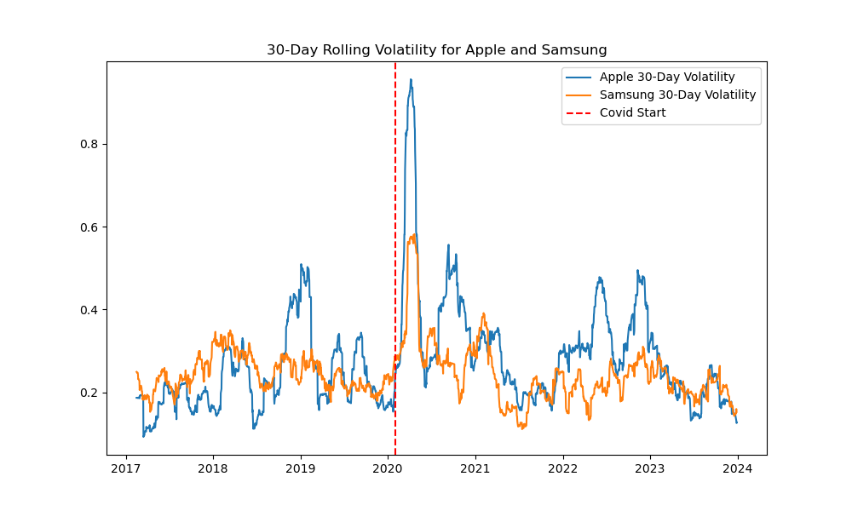
Was there an increase in stock price volatility for Apple and Samsung during the pandemic compared to pre – Covid period?

Slide 18
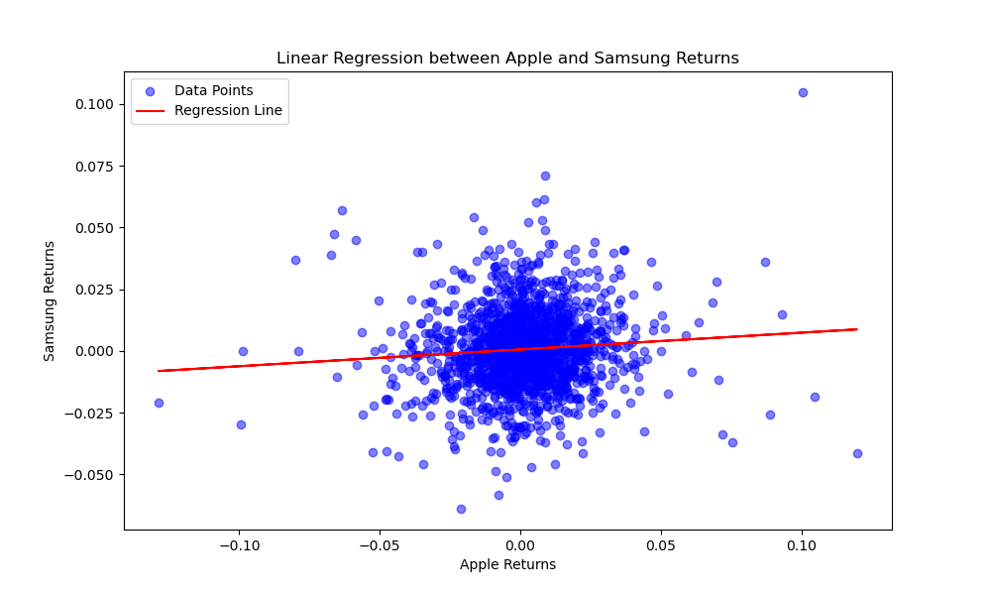
Was there an increase in stock price volatility for Apple and Samsung during the pandemic compared to pre – Covid period?

Slide 19
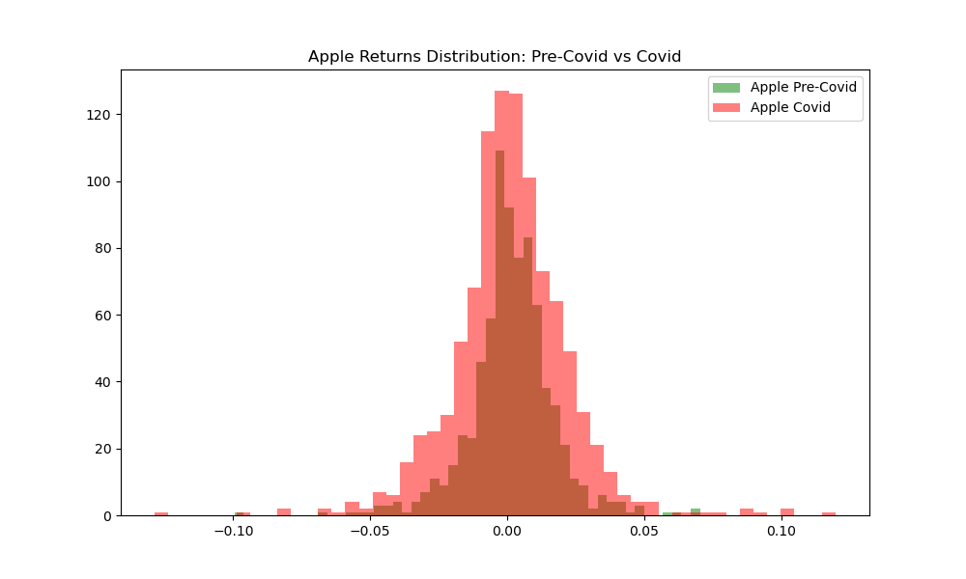
Was there an increase in stock price volatility for Apple and Samsung during the pandemic compared to pre – Covid period?

Slide 20
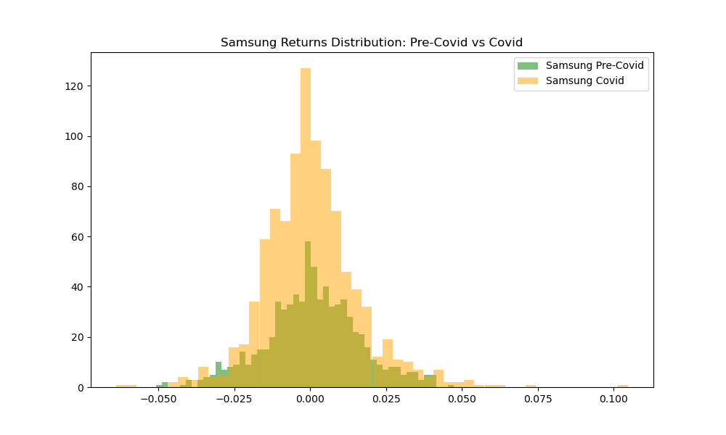
Was there an increase in stock price volatility for Apple and Samsung during the pandemic compared to pre – Covid period?

Slide 21
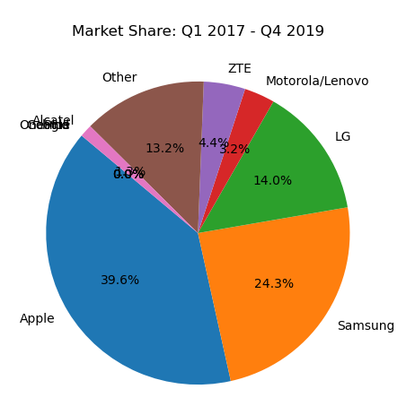
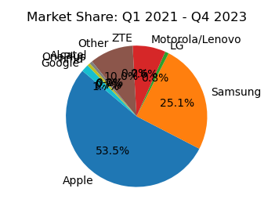
How did Apple and Samsung perform relative to the US Smartphone Market?
Samsung made marginal gains, remained 2nd By Wide Margin
Apple gained a majority of the Market

Slide 22
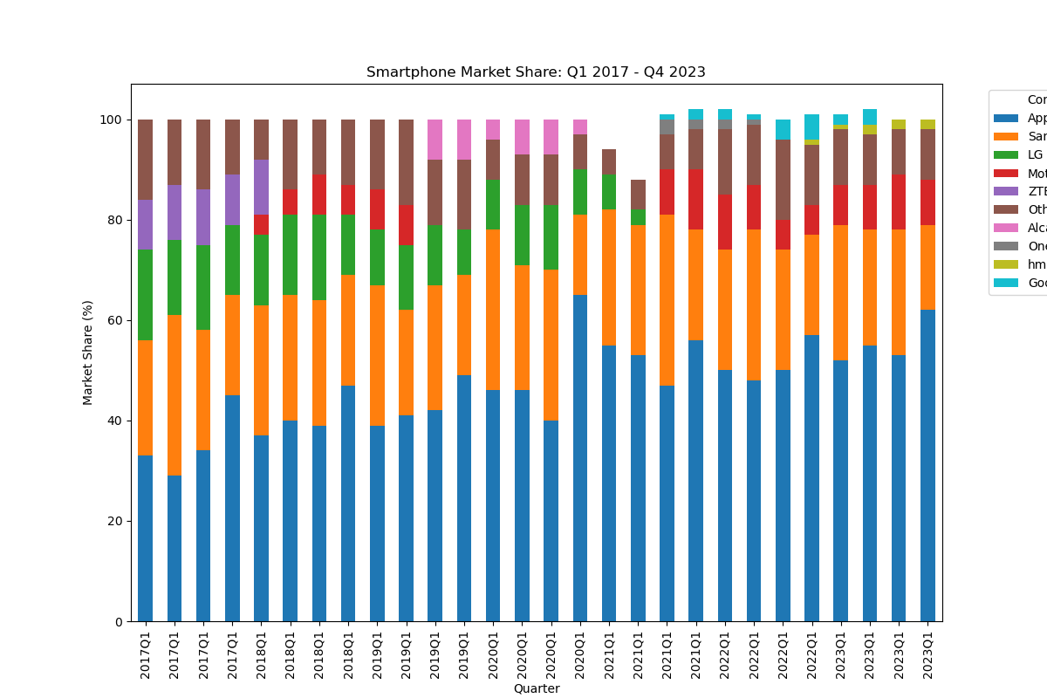
How did Apple and Samsung perform relative to the US Smartphone Market?

Slide 23
How did Apple and Samsung perform relative to the US Smartphone Market?
Benefited from privileged positions in respective countries
Certain players reorganized their companies
Other external factors impacted the market

Slide 24
FINAL THOUGHTS

Slide 25



Data From

